Slide 1

Overeaters Anonymous
Translations
Translate

Slide 2



Overeaters Anonymous is a Fellowship of individuals who, through shared experience, strength, and hope, are recovering from compulsive overeating. We welcome everyone who wants to stop eating compulsively. There are no dues or fees for members; we are self-supporting through our own contributions, neither soliciting nor accepting outside donations. OA is not affiliated with any public or private organization, political movement, ideology, or religious doctrine; we take no position on outside issues. Our primary purpose is to abstain from compulsive eating and compulsive food behaviors and to carry the message of recovery through the Twelve Steps of OA to those who still suffer.
Overeaters Anonymous Preamble
Embrace the similarities,
love the differences
in all our affairs

Slide 3



The Importance of Translating OA Literature
Carry the OA message )
Attract newcomers ) abstinence, recovery, identification
Work all Twelve Steps )
Do I belong?
Abstinence from Compulsive Eating
Twelve Steps

Slide 4
Priorities
When you work in committees, think back over your recovery and time in OA.
    Have you read all / most of our OA literature in English?
    Are you familiar with the resources that can be downloaded from oa.org ?
    What OA materials and literature helped you most in finding OA and recovering?
    What materials might OA members like to see in their own language?
    For suggestions about prioritizing, review the “Translated OA Literature Chart” and “Translated OA Recovery Materials.” Find these charts at oa.org/site-map; click “Literature Translations.”
    Currently, there is a suggested order for translating OA literature:
    1) Follow recommendations in the Translation Guidelines for OA Literature
    —review suggestions under “Where to Begin.”
    2) Follow recommendations in the Abstinence Literature Resource Guide.
    3) Translate everything else.

Slide 5


Why Translate OA Literature and Materials?
Within OA worldwide, relatively “small” countries can have more meetings per capita in comparison with some “larger” countries.
There seems to be a direct correlation between a country’s number of meetings (and thus recovery!) and the amount of translated literature available in its specific language.
Countries having a good supply of OA literature in their local languages is a direct result of members having a vision that ALL OA literature be translated and made available locally.
THE BOTTOM LINE? TRANSLATING LITERATURE SAVES LIVES!
Vision!

Slide 6
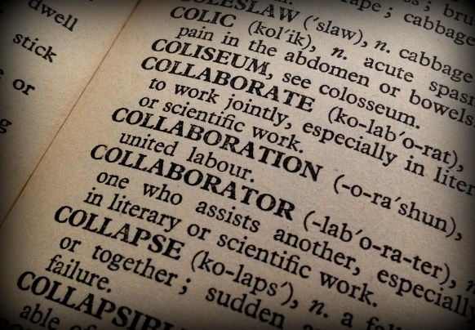
OA Glossary of Words and Terms
Translate a glossary of OA’s special program words.
“We’ve found it helpful to start by compiling a list of program terms in the local language, for example: Higher Power, abstinence, plan of eating, food plan, sponsor, surrender, one day at a time, relapse, program. These terms appear often in OA literature and need to be translated the same each time they appear” (Translation Guidelines for OA Literature).
OA uses many words and expressions that are not necessarily common in everyday use. If your committee translates a glossary of program words and terms, it will save time and ensure consistency with future translations.
Share your glossary with other groups and whenever you use a professional translator.
A master OA Glossary has been prepared in English.
Find it at oa.org/site-map; click “Literature Translations.”

Slide 7

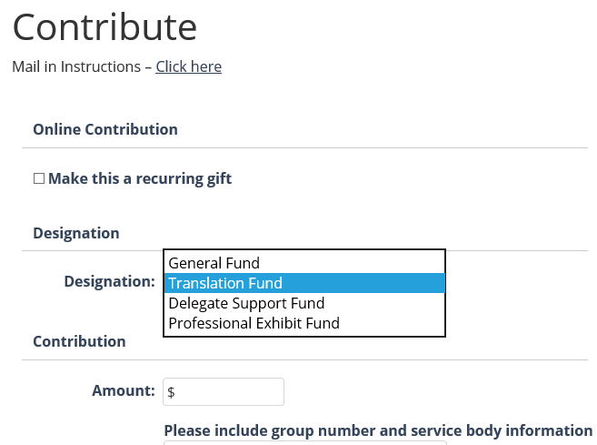
Translation Assistance Fund
Members may contribute to this new dedicated fund to help translations worldwide.
Help
Go to oa.org/contribute
to find a mail-in form
or make an online contribution.
If you want to pay into this fund,
be sure to choose “Translation Fund”
as the designation for your contributions.

Slide 8
Financial Assistance Available
How to apply
using the Translation Assistance Fund Application:
Find the form at oa.org/site-map; click “Literature Translations.”
Send completed applications to the World Service Office before February 1, June 1, or October 1 every year.
Watch for periodic reminders sent out by the WSO.
The Translations budget is approved by
the Board of Trustees (BOT) and allocated by the International Publications / Translations Committee.
Help
Regional assistance funds
may be available too.
Check with your region to see
if any translation funds are available (as in Region Nine)
and how to apply.

Slide 9
Translating Material from oa.org:
Documents, Text, and Downloads
Non-English-speaking registered groups and service bodies may now translate and distribute any downloadable document, file, or text on oa.org without seeking permission from the World Service Office. This does NOT include permission to reprint photos.
These new procedures and guidelines create greater parity among all OA groups and service bodies that wish to carry the message and support the recovery of our worldwide Fellowship. Translated OA documents must include the following citation, written in the language of the translation:
“This is a translation of OA-approved literature. © [date of translation]
Copyright Overeaters Anonymous, Inc. All rights reserved.”
Groups and service bodies are also required to provide a digital copy of any published translated literature to the WSO. For more information, go to oa.org/site-map; click “Copyright Requests.”

Slide 10


Translation Guidelines for OA Literature
This presentation contains a summary and the main points of the Translation Guidelines for OA Literature. Find the full document at oa.org/site-map; click “Literature Translations.”
It is suggested that your committee translate these Guidelines, as well as License 1 and License 2, so that translators can read them in your native language.

Slide 11
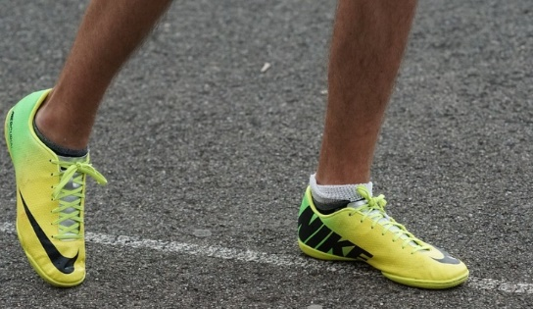
Translation Guidelines for OA Literature: a Summary
  Check before you start:
Is the literature you want to translate
– already translated / in the process of being translated
by another service body?
– due for a major revision soon? (Ask your region trustee or the WSO about scheduled revisions.)
Consider where this literature is in your priority list for translations.
Find out if financial assistance is available from regional translation budgets or OA, Inc.

Slide 12


2) Ensure accurate translation of original text.
i) Trust (Concept Three)
ii) Nothing left out
iii) Nothing added
iv) Same meaning and implication,
as closely as a different language allows
Original text has been approved by the OA Board of Trustees or OA worldwide through the World Service Business Conference .
It is permissible to alter measurement and weight references (e.g., change pounds and ounces to kilos and grams; change feet and inches to meters and centimeters).
Accuracy

Slide 13

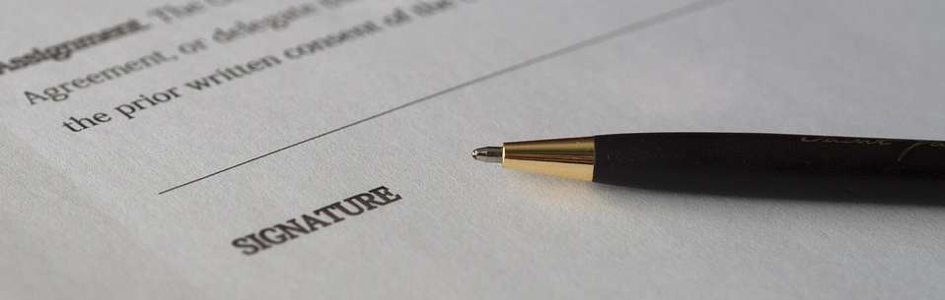
3) What is a License and why is it needed?
Licenses are agreements that protect copyright:
OA owns all its materials and text.
Complete one License at each stage of the two-step translation process.
Sign on behalf of your service body and send it to the WSO.
OA’s Managing Director / Corporate Secretary will sign for OA and retain a copy on file.
A signed copy of your license will be sent to your service body to keep.

Slide 14

4) The Two-Step Licensing Process
Licenses 1 and 2 are formal legal agreements
between your service body and OA, Inc.
concerning usage of OA’s copyrighted literature.
License 1 = permission to translate
License 2 = permission to publish and distribute
Remember, downloadable documents do not need a license,
but you do need to add an OA citation (© Overeaters Anonymous, Inc. All rights reserved)
and send a copy of your translation to the WSO.
Legal Agreement

Slide 15


License 1
License 1 gives permission to translate and circulate for validation.
“Validation” means testing a translation for accuracy before editing and approving it.
Your service body has:
- 18 months to complete the translation
- PLUS 6 more months to circulate and validate it
Be sure all drafts of the translation are returned and destroyed after the validation process is complete.
Once License 1 is approved, you may request the WSO send digital files of the most current version of the literature to be translated.

Slide 16


License 2
License 2 gives permission to print and distribute.
(Includes approval to use a customized OA logo.)
Signing License 2 means your service body agrees:
  Every copy will have the correct copyright notice.
  Every copy will have a specific, customized OA logo.
  One printed and one electronic copy will be sent to WSO.
  Royalties will be sent to the WSO (10% of net sales).
  All surplus funds (after royalties) will be used for OA.

Slide 17


5) Translations Committees
Form structures for development of translations in your language.
This service in OA is best performed by a group of members:
“Together we can.”
A translations committee avoids overdependence on individual members.
Priorities for a committee might include reviewing these items:
  • Glossary of OA words and terms (Service bodies do not need a license to translate a glossary.)
  • Suggested priorities from the Translation Guidelines for OA Literature
  • Tradition Four
  • Abstinence Literature Resource Guide
  (at oa.org/documents, under “Group Support”)

Slide 18



6) Suggestions For Choosing Translators
OA members are often the best choice.
Members understand our literature and want the best for OA. They may take longer, or start but not finish, but OA members put love and effort into translating.
Professional translators can work too.
If employing a professional translator, make sure to use a contract right from the beginning. Give them your glossary of OA terms!

Slide 19



7) Validating (a)
Check for clarity and translator’s general understanding.
Additional suggestions:
– Use a draft in an OA meeting:
read a few paragraphs and discuss the clarity of the message.
– Meet in small groups / committees to review the translation.
– Use a draft in discussions with sponsees.

Slide 20

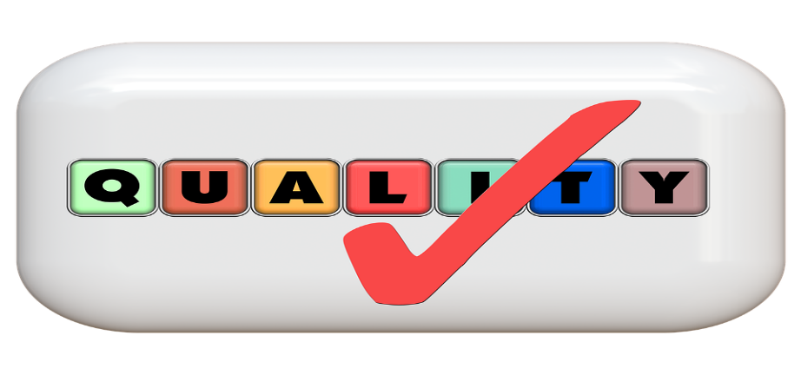
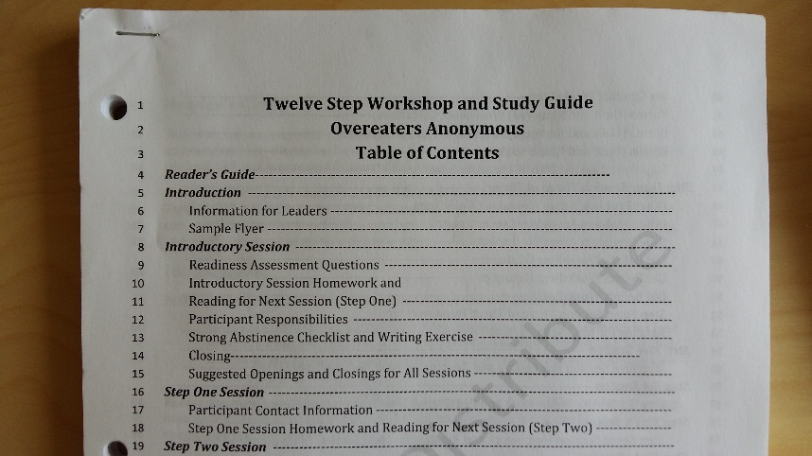
7) Validating (b)
                Circulate drafts for consideration by members who speak the local language. Have them check concepts and usage (good grammar).
Number the lines of text. This makes it easier
to relay specific comments about the draft.
Use printed copies wherever possible
so members can write comments.
Write DRAFT or COPY on these for clarification.
CONTENT – grammar / spelling / context

Slide 21

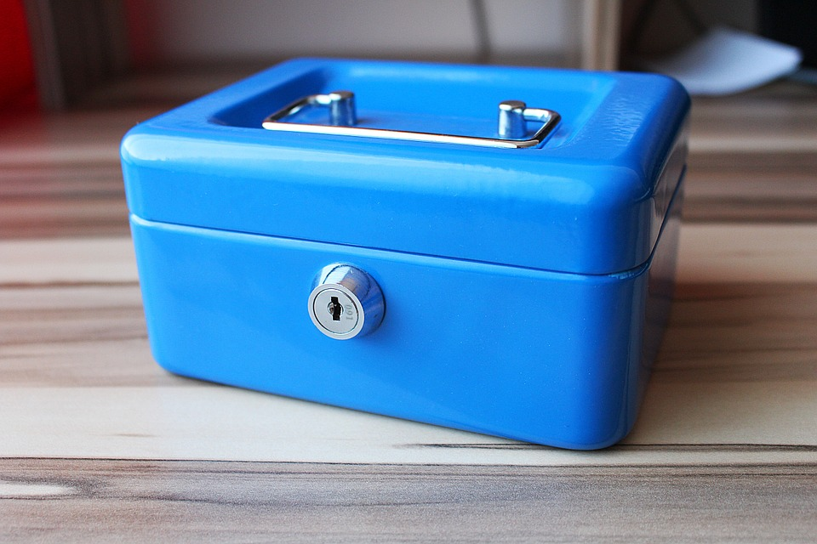

7) Validating (c)
Possibly charge money for a draft and organize your records so that any amount paid can be deducted from the purchase price of the final approved copy. (Make sure you set prices so that you make a surplus to fund your next round of translations.)
<-Future Translations fund
Have everyone send reviewed copies to one collection point. At the end of the validation period, destroy all draft copies.

Slide 22


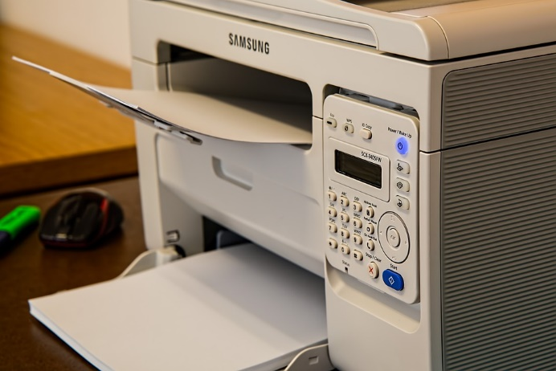
8) Printing
Translated and reprinted from _____________ [Title, item number, and latest copyright date of English version], Copyright © ________ [year of
translation] of the _____________ [language of translation] version.
Overeaters Anonymous, Inc. World Service Office,
6075 Zenith Court NE, Rio Rancho, NM USA 87144.
Mail address: PO Box 44020, Rio Rancho, NM USA 87174-4020. Telephone: 1-505-891-2664.
Email info@oa.org. Website www.oa.org.
With the permission of OVEREATERS ANONYMOUS, INC. All rights reserved. No part of this publication may be reproduced in any form without the prior written consent of OVEREATERS ANONYMOUS, INC.”
SERVICE BODY NAME (REQUIRED)
Local contact:
XYZ Language Service Board
24 Fictitious Street, Somewhere, EXAMPLE
Local or regional phone number / website
If cost is a concern, consider printing from a home computer initially.
Perform a final check for errors before printing.
Make sure to include:
– Copyright notice
– WSO contact information
– Your customized logo
– Local country or region contact details

Slide 23

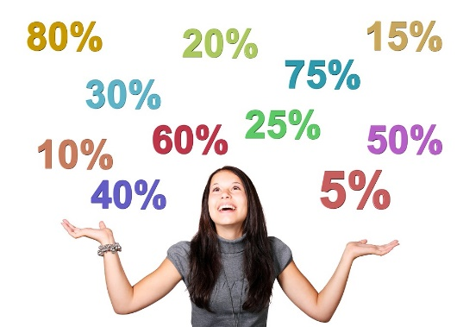
9) Selling and Royalties (a)
Set the selling price to make a surplus.
Example: gross profit 60% of sales; production costs 40%.
If it costs €1500 to produce the literature, divide by .40 (= €3750). Then divide that figure by the number of items to be printed.
€3750 / 500 copies = €7.50 per copy
Setting an appropriate selling price will give your service body enough funds to cover costs and build up a prudent reserve for more translations.

Slide 24
9) Selling and Royalties (b)
Royalties due to OA, Inc. are 10% of net income from sales
on translated OA literature. Consider putting a line item in the budget for this.
License 2, Clause 7: Royalty
For the rights granted by Licensor, Licensee agrees to pay to Licensor a royalty calculated as follows:
10% of Net Income from the sale of licensed OA publication.
Royalties shall be due and payable thirty (30) days after the first and each successive anniversary of the Effective Date of this Agreement.
Net Income is defined as the excess of the selling price of goods over their direct cost.
The remaining Net Income the Licensee derives directly or indirectly from sale, distribution or other disposition of the Final Translation will be used exclusively for the not-for-profit purposes for which the Licensee was organized.

Slide 25


Why do we translate OA Literature?
Because of our OA Responsibility Pledge.
Always to extend
the hand and heart of OA
to all who share my compulsion; for this I am responsible.
Notes:
Suggest to end meetings / workshops and try to encourage use of the Responsibility Pledge

Slide 26

Thank you for your interest and your service.
Various text has been extracted from the Translations Guidelines for OA Literature,© 2014 Overeaters Anonymous, Inc. (Rev. 2015). All rights reserved.
Pictures are from copyright-free sources.
OA Board-Approved. © 2018 Overeaters Anonymous, Inc. All rights reserved.

